Slide 1


Java SE
(Core JAVA)
Lecture-13

Slide 2
Today’s Agenda
Object Oriented Programming.
Classes and Objects.
Pillars of Object Oriented Programming
Creating a class and its object.

Slide 3
Object Oriented Programming
A programming paradigm which is based on real world model of objects or entities.
It is organized around objects rather than "actions" and data rather than “logic”.
Object-oriented programming takes the view that what we really care about are the objects we want to manipulate rather than the logic required to manipulate them.

Slide 4
Objects
In programming any real world entity which has specific attributes or features can be represented as an Object.
Along with attributes each object can take some actions also which are called it’s “behaviors”
In programming world, these attributes are called data members and behaviours/actions are called “functions” or “methods”

Slide 5
Are you an object ?
Yes , we humans are objects because:
We have attributes as name, height, age etc.
We also can show behaviors like walking, talking, running, eating etc

Slide 6
Classes
Now to create/represent objects we first have to write all their attributes under a single group .
This group is called a class
A class is used to specify the basic structure of an object and it combines attributes and methods to be used by an object
Thus we can say that a class represents the data type and object represents a kind of variable of that data type
For Example:- Each person collectively come under a class called Human Being. So we belong to the class Human Being.

Slide 7
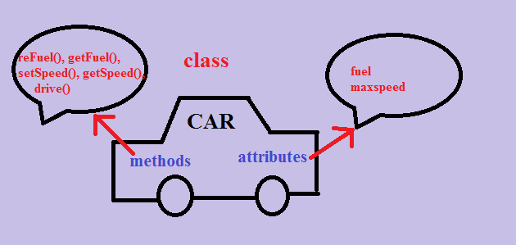
Objects and Classes

Slide 8
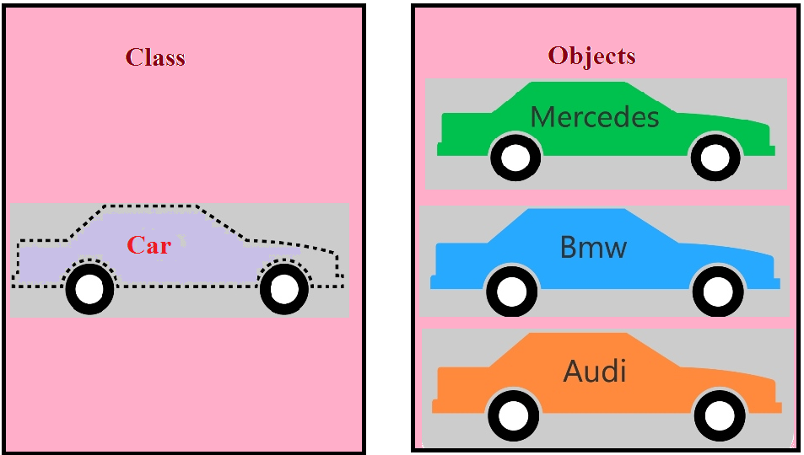
Objects and Classes

Slide 9
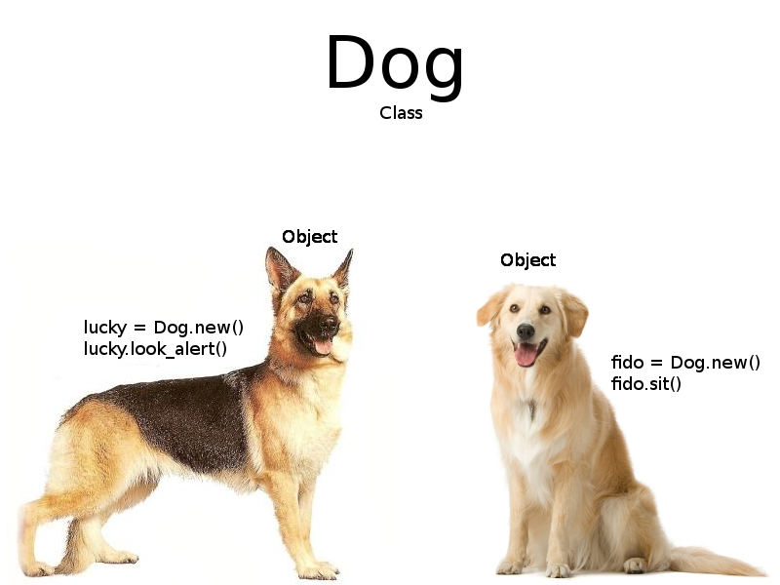
Objects and Classes

Slide 10
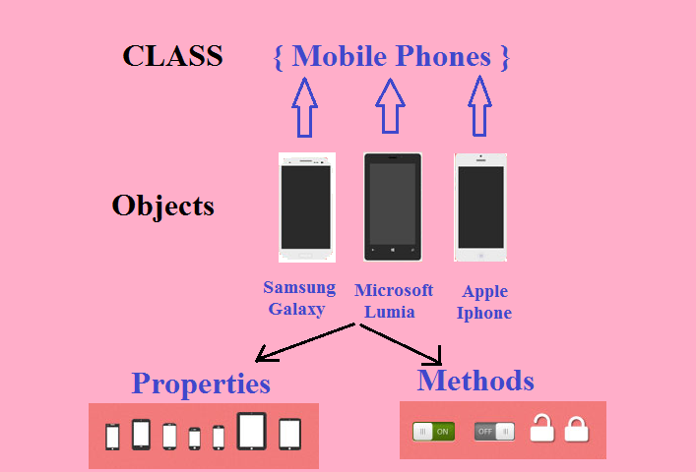
Objects and Classes

Slide 11
Pillars of OOP
The Object Oriented Programming paradigm stands on 3 main pillars, which are :-
Abstraction and Encapsulation
Polymorphism
Inheritance

Slide 12
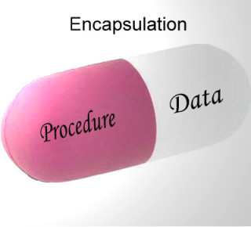
Abstraction and Encapsulation
Abstraction : Focus on the meaning i.e. Suppress irrelevant “implementation” details.
Encapsulation is a process of binding or wrapping the data and the codes that operates on the data into a single entity.
Abstraction and Encapsulation go hand in hand.

Slide 13
Polymorphism
Poly- Many
Morph- Forms
Polymorphism refers to a principle in biology in which an organism or species can have many different forms or stages.
Have you seen how you perform polymorphism in day to day life?

Slide 14
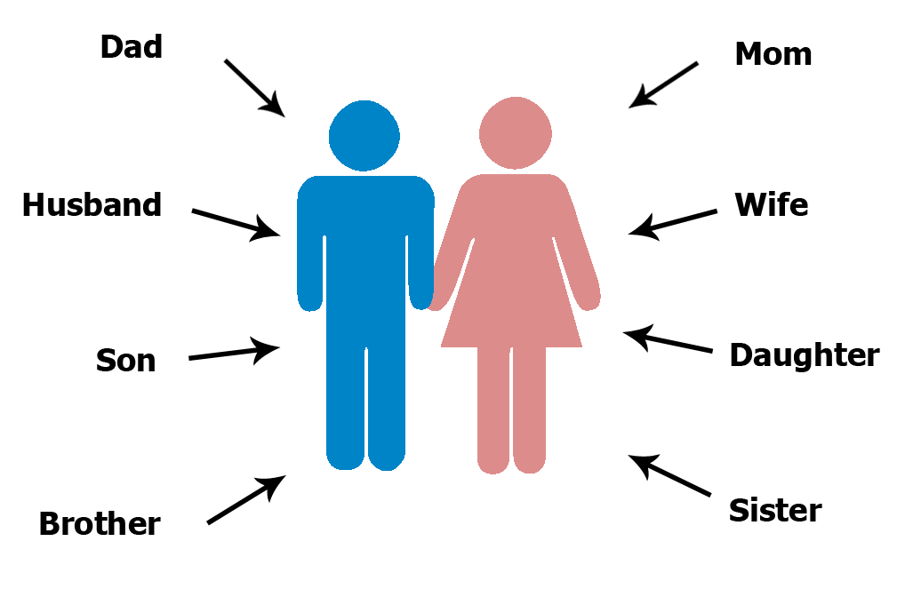
Example

Slide 15
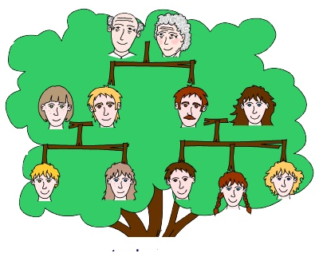
Inheritance
A process by which one class can acquire properties of another class.
Example:- We inherit characteristics from our parents.

Slide 16
Advantages of inheritance
Reusability
Extensibility
Information is made manageable in a hierarchical order.

Slide 17
Creating a class and its object
Syntax :-
class <class name>
{
<access modifier> <data type> <variable name>= value;
-
-
-
<access modifier> <return type> <method name>(arguments)
{
// Method body
}
}
Optional

Slide 18
0
Example :-
class Student
{
int roll;
char grade;
float per;
}
class UseStudent
{
public static void main(String [ ] args)
{
Student s;
s=new Student();
}
}
1000
0
‘\n’
0.0
roll
grade
per
1000
s

Slide 19
Continued Program
class UseStduent
{
public static void main(String [ ] args)
{
Student s;
s=new Student( );
s.roll=10;
s.grade=‘A’;
s.per=66.5f;
S.O.P(“Roll is ”+s.roll);
S.O.P(“Grade is ”+s.grade);
S.O.P(“Percentage is ”+s.per);
}
}
Does this code violate the rules of Object Oriented Programming ???
It violates the rule of Encapsulation.

Slide 20
Access Modifiers
There are 4 access modifiers provided by java which are,
public
private
protected
default
public and private are of importance to us unless we learn “Packages” in Java.

Slide 21

End Of Lecture 13
For any queries mail us @: scalive4u@gmail.com
Call us @ : 0755-4271659, 7879165533
Agenda for Next Lecture:
Creating methods in a class.
Using methods to initialize data members.
Creating parameterized methods.

